Slide 1

Bus Transport Management System
End-to-end full-stack application for managing buses, routes, schedules, and seats — built with React, Spring Boot, Docker, SonarQube, Vercel, and Render.

Slide 2

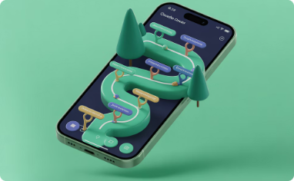

Project Overview
What it does
Key features
Why it matters
Full-stack web app to manage buses, routes, timetables, and seat allocations.
Route planning, schedule management, dynamic seat availability, and real-time updates.
Improves operational efficiency, rider experience, and simplifies fleet management at scale.

Slide 3

Project Objectives
Modular Backend
Responsive Frontend
Code Quality
Design a Spring Boot service layer (Controller → Service → Repository) for maintainability and testability.
Build a component-driven React UI with accessible patterns and mobile-first responsiveness.
Integrate SonarQube to detect bugs, vulnerabilities, and code smells—enforce Quality Gate.
Cloud Deployment
Use Docker for consistent runtime; deploy frontend on Vercel and backend on Render for scalable production.

Slide 4
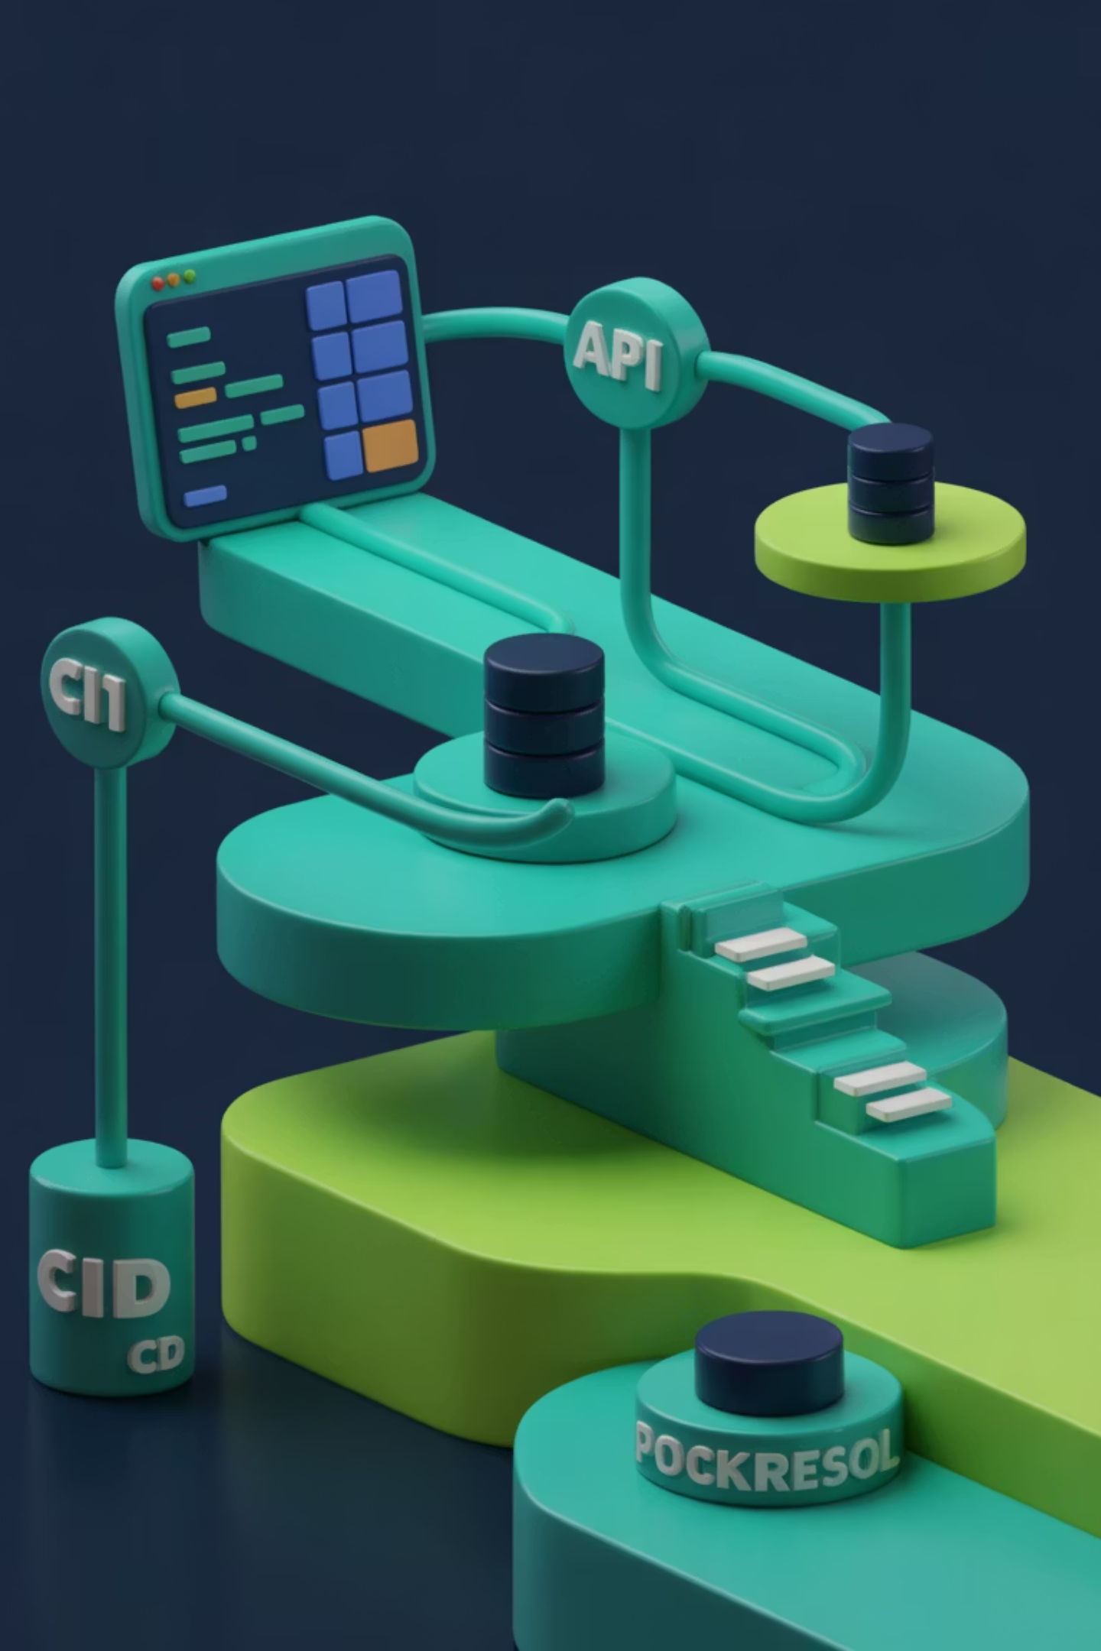
System Architecture
React frontend ↔ REST APIs ↔ Spring Boot backend. Persistent data stored in relational DB. CI via GitHub Actions triggers Docker builds and SonarQube analysis before deployment to cloud services.
Frontend
Backend
Infrastructure
SPA in React, component library, client-side routing, Axios for HTTP.
Spring Boot microservice(s), REST controllers, service layer, JPA repositories.
Dockerized services, CI/CD, SonarQube quality checks, cloud hosting on Vercel & Render.

Slide 5
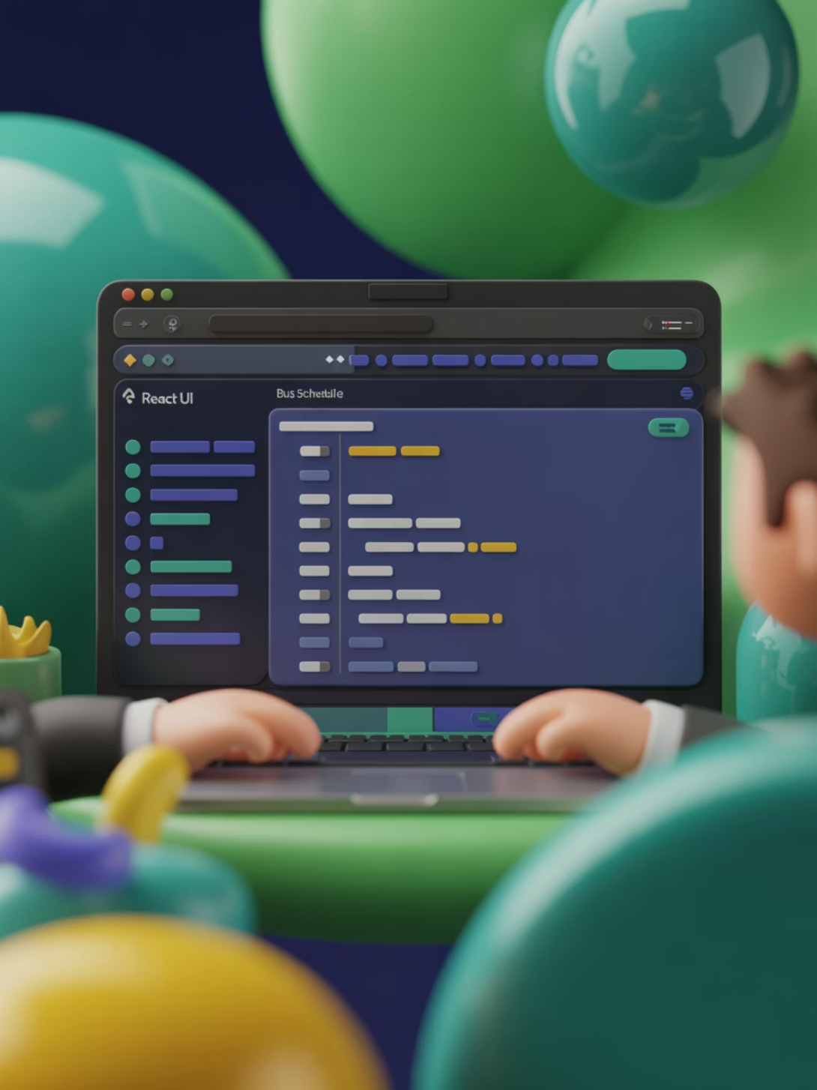
Frontend Development
React with functional components and hooks for predictable state.
Axios for typed API calls; centralized API client and interceptors for auth and error handling.
Responsive layouts, accessibility (ARIA), and unit tests with Jest + React Testing Library.
Deployed to Vercel with preview URLs for every PR.

Slide 6
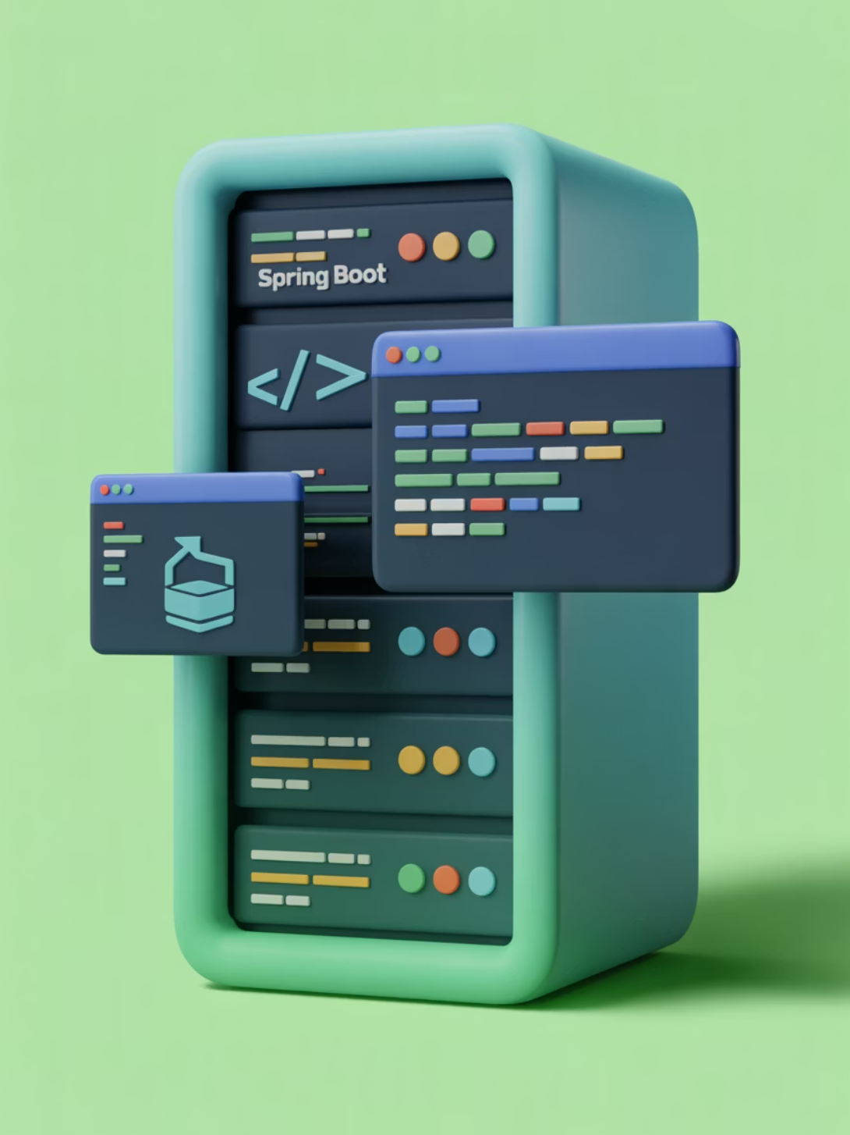
Backend Development
Spring Boot (Maven) with layered architecture: Controller → Service → Repository → Entity.
RESTful endpoints returning JSON with clear status codes and error payloads.
Data persistence via JPA/Hibernate and connection pooling for performance.
Automated tests (unit & integration) and health endpoints for monitoring. Deployed on Render.

Slide 7
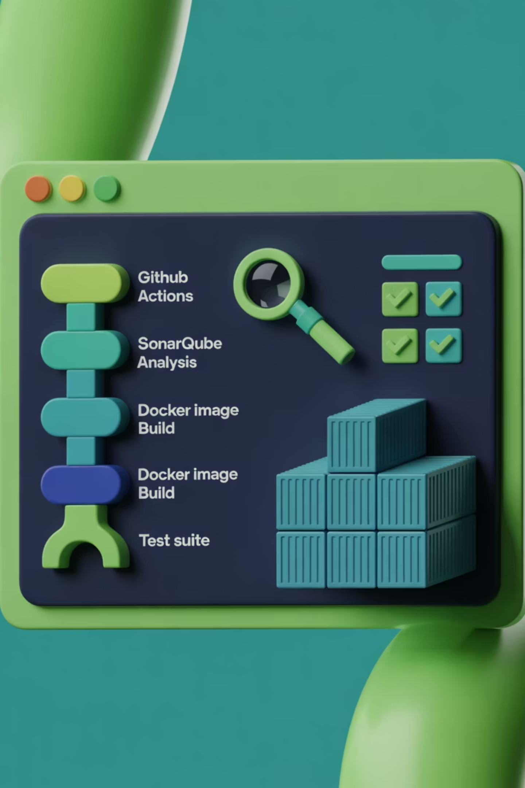
CI & SonarQube Integration
GitHub Actions pipeline runs on every PR: install, build, run tests, SonarQube scan, and Docker image build. Quality Gate blocks merges on critical issues.
Checks
Unit tests, integration tests, linting, and security scanning.
SonarQube
Detects bugs, vulnerabilities, duplicated code, and enforces code coverage thresholds.
Outcomes
Quality Gate passed; improved maintainability and earlier issue detection.

Slide 8
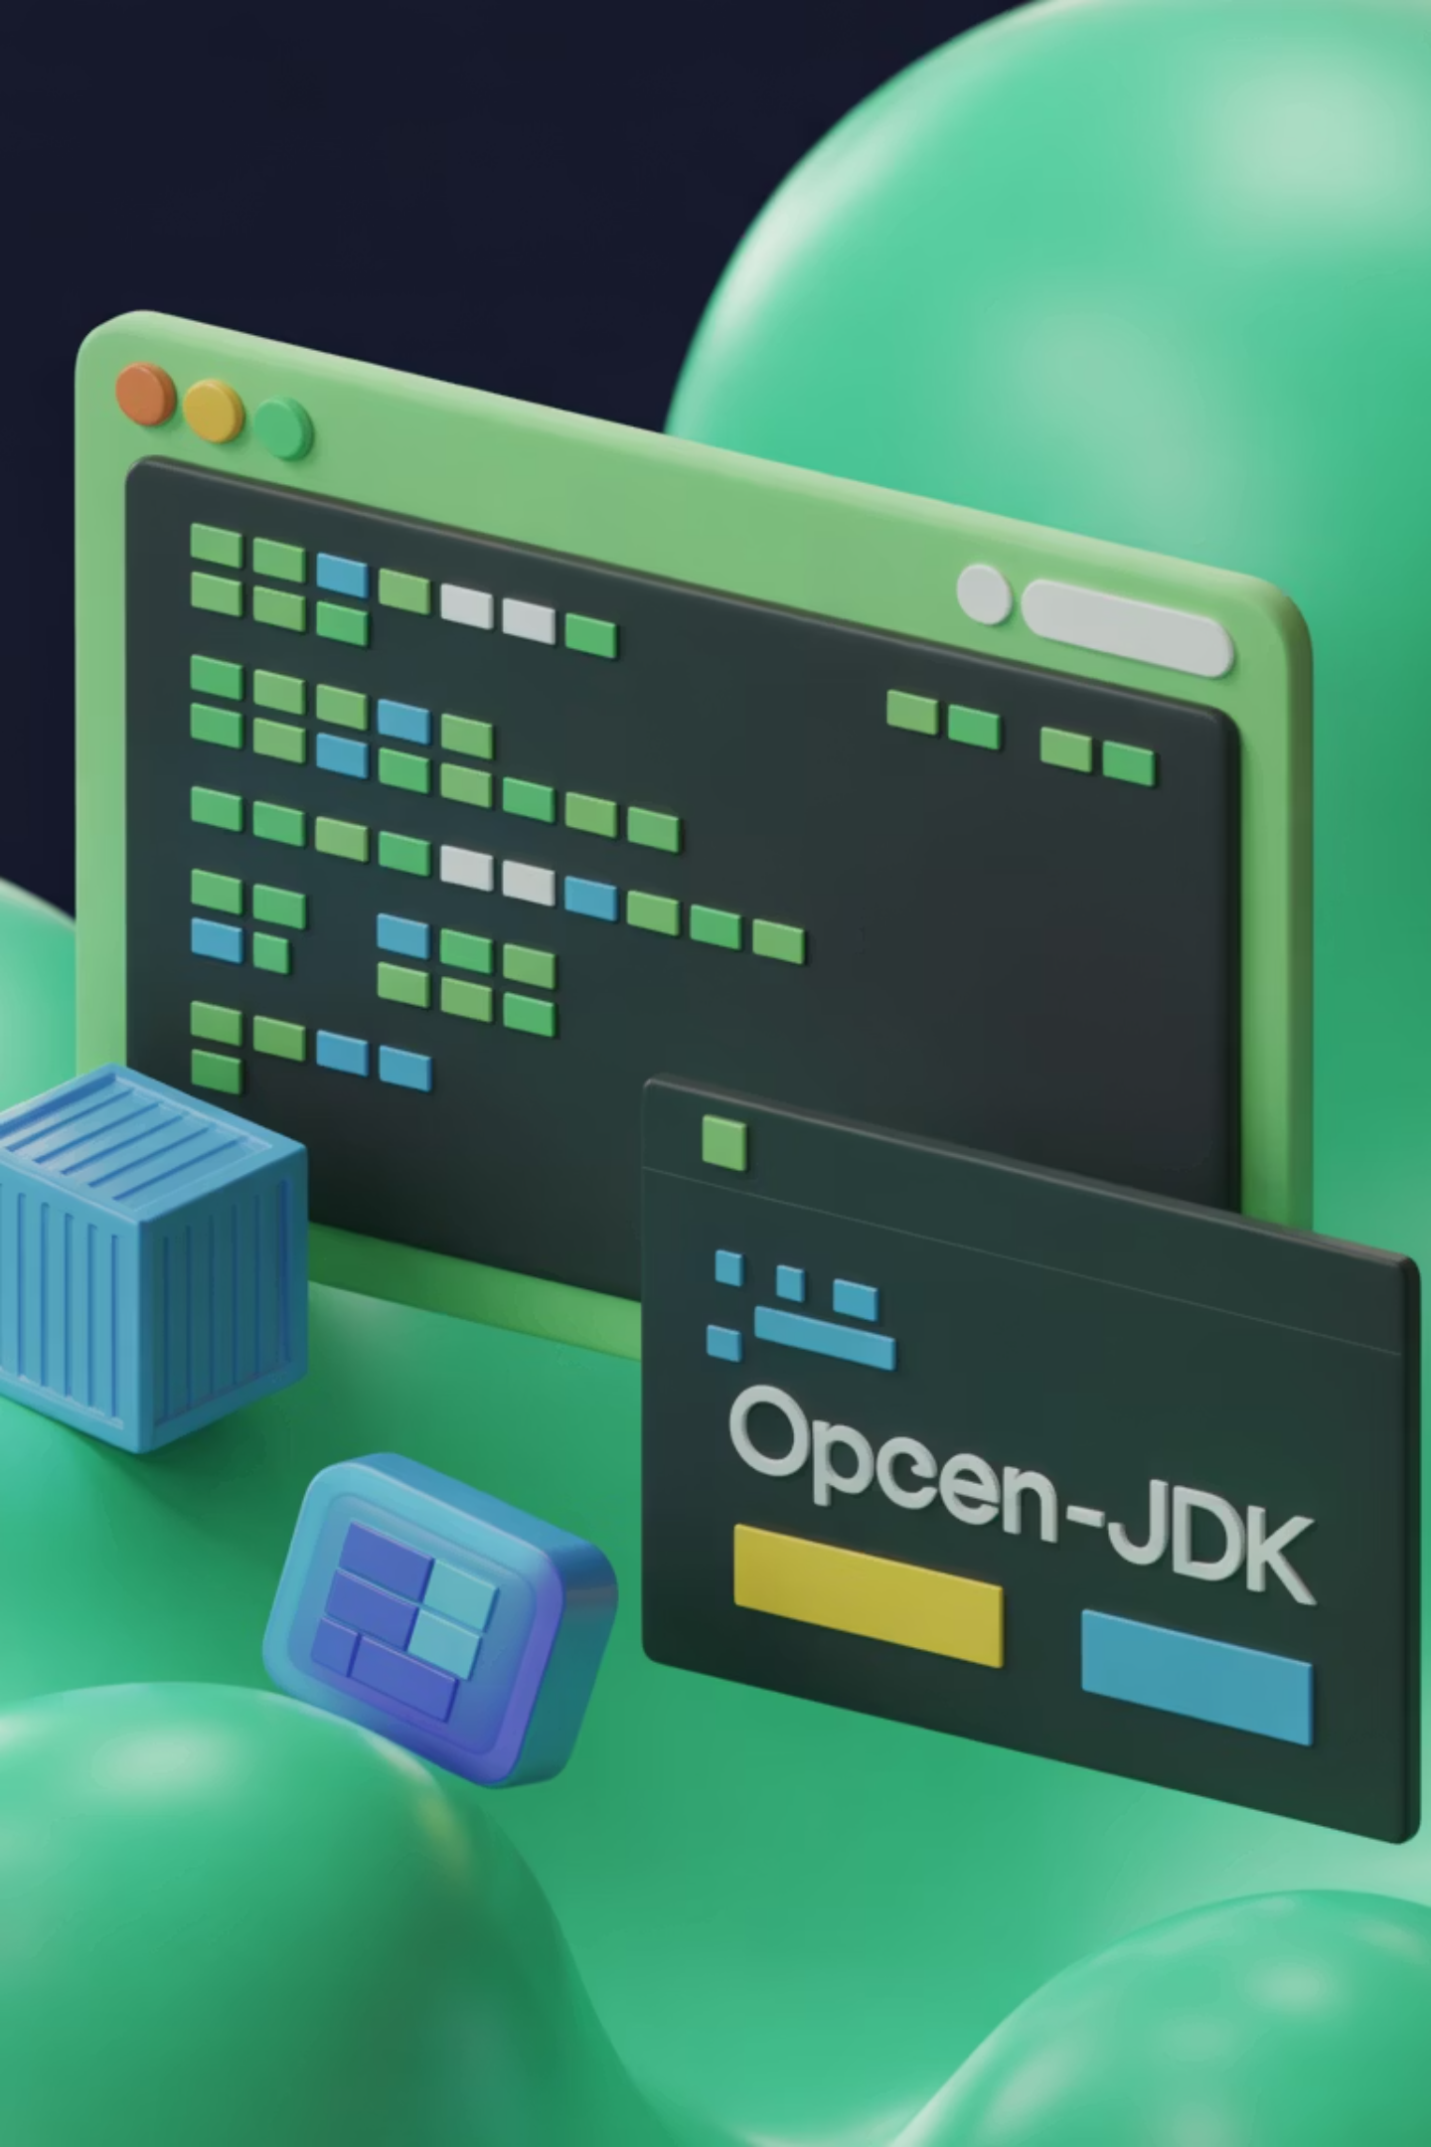

Dockerization
Backend packaged as a Docker image using an OpenJDK base. Multi-stage build minimizes image size and surface area. Containers ensure consistent runtime across environments and simplify CI/CD.
Consistency
Identical environments from local dev to production.
Fast CI Builds
Layered caching for quick image rebuilds during iterative development.
Security
Scan images for vulnerabilities before deployment.

Slide 9

Deployment
Frontend (Vercel)
Backend (Render)
Continuous deployment from main branch; instant preview URLs on PRs; CDN-backed static hosting for low-latency UI delivery.
Docker-based service with auto-deploy on image push, autoscaling, environment variable secrets, and managed PostgreSQL for persistence.
Public URLs provided for stakeholder review and QA; monitoring and logs available for production diagnostics.

Slide 10


Issues Faced & Solutions
CORS
Problem: Cross-origin requests blocked in browser. Solution: Configured CORS in Spring Security for allowed origins and used consistent API base URL across environments.
Port Conflicts
Problem: Local and container ports collided. Solution: Standardized port map and made ports configurable via env vars.
SonarQube Findings
Problem: Quality issues and code smells. Solution: Targeted refactors, removed duplication, added unit tests, and raised CI gate thresholds.
Docker / Virtualization
Problem: Docker failing on developer machines. Solution: Enabled virtualization, provided a lightweight dev compose, and documented troubleshooting steps.
Next steps: Harden security (auth tokens, rate limits), add observability (metrics/tracing), and roll out phased production testing with stakeholders.

